Slide 1
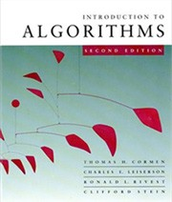

Introduction to Algorithms
6.046J/18.401J LECTURE 10
Balanced Search Trees
Red-black trees
Height of a red-black tree
Rotations
Insertion
Prof. Erik Demaine
Copyright © 2001-5 by Erik D. Demaine and Charles E. Leiserson
October 19, 2005
L7.1

Slide 2
Balanced search trees
Balanced search tree: A search-tree data structure for which a height of O(lg n) is guaranteed when implementing a dynamic set of n items.
AVL trees
2-3 trees
Examples:
2-3-4 trees
B-trees
Red-black trees
October 19, 2005
Copyright © 2001-5 by Erik D. Demaine and Charles E. Leiserson
L7.2

Slide 3
Red-black trees
This data structure requires an extra one-bit color field in each node.
Red-black properties:
Every node is either red or black.
The root and leaves (NIL’s) are black.
If a node is red, then its parent is black.
All simple paths from any node x to a descendant leaf have the same number of black nodes = black-height(x).
October 19, 2005
Copyright © 2001-5 by Erik D. Demaine and Charles E. Leiserson
L7.3

Slide 4
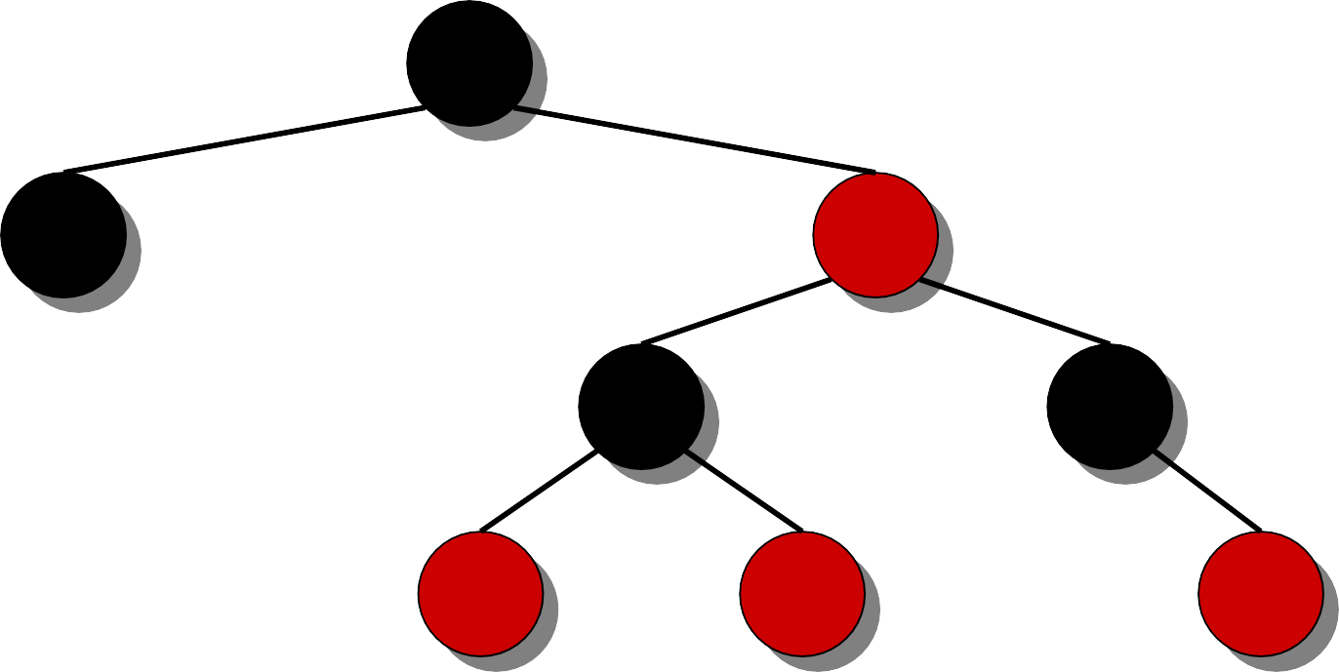
Example of a red-black tree
7
3 1 8
NIL NIL
1 0 2 2
h = 4
NIL
8
NIL NIL NIL NIL
1₁1₁
2₂6₆
NIL NIL
October 19, 2005
Copyright © 2001-5 by Erik D. Demaine and Charles E. Leiserson
L7.4

Slide 5
Example of a red-black tree
7₇
3₃
NIL NIL
 | 1₁8₈
 | 1₁0₀ | 2₂2₂
NIL | NIL 8₈ 1₁1₁ 2₂6₆ NIL NIL NIL NIL NIL
1. Every node is either red or black.
October 19, 2005
Copyright © 2001-5 by Erik D. Demaine and Charles E. Leiserson
L7.5

Slide 6
Example of a red-black tree
7₇
3₃
NIL NIL
 | 1₁8₈
 | 1₁0₀ | 2₂2₂
NIL | NIL 8₈ 1₁1₁ 2₂6₆ NIL NIL NIL NIL NIL
2. The root and leaves (NIL’s) are black.
October 19, 2005
Copyright © 2001-5 by Erik D. Demaine and Charles E. Leiserson
L7.6

Slide 7
Example of a red-black tree
7₇
3₃
NIL NIL
 | 1₁8₈
 | 1₁0₀ | 2₂2₂
NIL | NIL 8₈ 1₁1₁ 2₂6₆ NIL NIL NIL NIL NIL
3. If a node is red, then its parent is black.
October 19, 2005
Copyright © 2001-5 by Erik D. Demaine and Charles E. Leiserson
L7.7

Slide 8
Example of a red-black tree
7₇
bh = 2
3₃
1₁8₈
bh = 2
NIL NIL
bh = 1
1₁0₀
2₂2₂
NIL
bh = 1
bh = 0 NIL
8₈ 1₁1₁ 2₂6₆
NIL NIL NIL NIL NIL
4. All simple paths from any node x to a descendant leaf have the same number of black nodes = black-height(x).
October 19, 2005 Copyright © 2001-5 by Erik D. Demaine and Charles E. Leiserson
L7.8

Slide 9
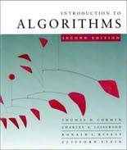
Height of a red-black tree
Theorem. A red-black tree with n keys has height
h ≤ 2 lg(n + 1).
Proof. (uses induction.)
October 19, 2005
Copyright © 2001-5 by Erik D. Demaine and Charles E. Leiserson
L7.9

Slide 10
Query operations
Corollary. The queries SEARCH, MIN, MAX, SUCCESSOR, and PREDECESSOR
all run in O(lg n) time on a red-black tree with n nodes.
October 19, 2005
Copyright © 2001-5 by Erik D. Demaine and Charles E. Leiserson
L7.16

Slide 11
Modifying operations
The operations INSERT and DELETE cause modifications to the red-black tree:
the operation itself,
color changes,
restructuring the links of the tree via
“rotations”.
October 19, 2005
Copyright © 2001-5 by Erik D. Demaine and Charles E. Leiserson
L7.17

Slide 12
Rotations
B_{B}
RIGHT-ROTATE(B)
A_{A}
A_{A}
LEFT-ROTATE(A)
B_{B}
γ
α
α β
β
γ
Rotations maintain the inorder ordering of keys:
a ∈ α, b ∈ β, c ∈ γ ⇒ a ≤ A ≤ b ≤ B ≤ c.
A rotation can be performed in O(1) time.
October 19, 2005
Copyright © 2001-5 by Erik D. Demaine and Charles E. Leiserson
L7.18

Slide 13
Insertion into a red-black tree
IDEA: Insert x in tree. Color x red. Only red- black property 3 might be violated. Move the violation up the tree by recoloring until it can be fixed with rotations and recoloring.
7₇
Example:
3₃
1₁8₈
1₁0₀
2₂2₂
8₈
1₁1₁
2₂6₆
October 19, 2005
Copyright © 2001-5 by Erik D. Demaine and Charles E. Leiserson
L7.19

Slide 14

Insertion into a red-black tree
IDEA: Insert x in tree. Color x red. Only red- black property 3 might be violated. Move the violation up the tree by recoloring until it can be fixed with rotations and recoloring.
7₇
Example:
Insert x =15.
3₃
1₁8₈
Recolor, moving the violation up the tree.
1₁0₀
2₂2₂
8₈
1₁1₁
1₁5₅
2₂6₆
October 19, 2005
Copyright © 2001-5 by Erik D. Demaine and Charles E. Leiserson
L7.20

Slide 15
Insertion into a red-black tree
IDEA: Insert x in tree. Color x red. Only red- black property 3 might be violated. Move the violation up the tree by recoloring until it can be fixed with rotations and recoloring.
7₇
Example:
Insert x =15.
3₃
1₁8₈
Recolor, moving the violation up the tree.
RIGHT-ROTATE(18).
1₁0₀
2₂2₂
8₈
1₁1₁
1₁5₅
2₂6₆
October 19, 2005
Copyright © 2001-5 by Erik D. Demaine and Charles E. Leiserson
L7.21

Slide 16

Insertion into a red-black tree
IDEA: Insert x in tree. Color x red. Only red- black property 3 might be violated. Move the violation up the tree by recoloring until it can be fixed with rotations and recoloring.
7₇
Example:
Insert x =15.
3₃
1₁0₀
Recolor, moving the violation up the tree.
RIGHT-ROTATE(18).
LEFT-ROTATE(7) and recolor.
8₈
1₁8₈
1₁1₁ 2₂2₂
1₁5₅ 2₂6₆
October 19, 2005 Copyright © 2001-5 by Erik D. Demaine and Charles E. Leiserson
L7.22

Slide 17

Insertion into a red-black tree
IDEA: Insert x in tree. Color x red. Only red- black property 3 might be violated. Move the violation up the tree by recoloring until it can be fixed with rotations and recoloring.
Example:
Insert x =15.
Recolor, moving the violation up the tree.
RIGHT-ROTATE(18).
1₁0₀
7₇
1₁8₈
3₃
8₈
1₁1₁ 2₂2₂
1₁5₅ 2₂6₆
LEFT-ROTATE(7) and recolor.
October 19, 2005 Copyright © 2001-5 by Erik D. Demaine and Charles E. Leiserson
L7.23

Slide 18
Pseudocode
RB-INSERT(T, x) TREE-INSERT(T, x)
color[x] ← RED ⊳ only RB property 3 can be violated
while x ≠ root[T] and color[p[x]] = RED
do if p[x] = left[p[p[x]]
then y ← right[p[p[x]]
if color[y] = RED
then ⟨Case 1⟩
else if x = right[p[x]]
then ⟨Case 2⟩
⊳ y = aunt/uncle of x
⊳ Case 2 falls into Case 3
⟨Case 3⟩
else ⟨“then” clause with “left” and “right” swapped⟩
color[root[T]] ← BLACK
October 19, 2005
Copyright © 2001-5 by Erik D. Demaine and Charles E. Leiserson
L7.24

Slide 19
Graphical notation
Let denote a subtree with a black root.
All ’s have the same black-height.
October 19, 2005
Copyright © 2001-5 by Erik D. Demaine and Charles E. Leiserson
L7.25

Slide 20
Case 1
Recolor
C
C
new x
D
C
C
A
x
y
D
A
B
B
(Or, children of
A are swapped.)
Push C’s black onto A and D, and recurse, since C’s parent may be red.
October 19, 2005
Copyright © 2001-5 by Erik D. Demaine and Charles E. Leiserson
L7.26

Slide 21
Case 2
LEFT-ROTATE(A)
C
C_{C}
y
y
A
x
B_{B}
B
x
A_{A}
Transform to Case 3.
October 19, 2005
Copyright © 2001-5 by Erik D. Demaine and Charles E. Leiserson
L7.27

Slide 22
Case 3
RIGHT-ROTATE(C)
y
A_{A}
C
B
B
C
x
A
Done! No more violations of RB property 3 are possible.
October 19, 2005
Copyright © 2001-5 by Erik D. Demaine and Charles E. Leiserson
L7.28

Slide 23
Analysis
Go up the tree performing Case 1, which only recolors nodes.
If Case 2 or Case 3 occurs, perform 1 or 2 rotations, and terminate.
Running time: O(lg n) with O(1) rotations.
RB-DELETE — same asymptotic running time and number of rotations as RB-INSERT (see textbook).
October 19, 2005
Copyright © 2001-5 by Erik D. Demaine and Charles E. Leiserson
L7.29

